Slide 1
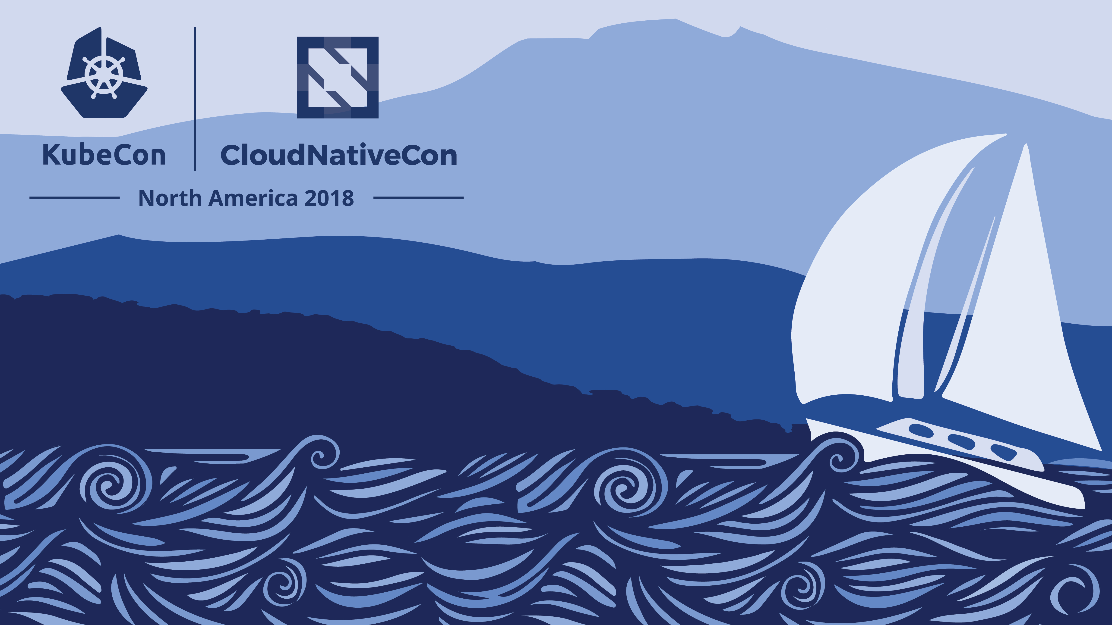
Managed Kubernetes Service in the Enterprise Daniel Selman - Kubernetes Consultant - Daniel.Selman@microsoft.com Sujit D’Mello - Principal Consultant - Sujit.DMello@microsoft.com
Notes:
Intros, Sujit sets context

Slide 2

Agenda
Security
Monitoring
Management all the way
Startup Scripts
Additional Topics
Demos
Managed K8s - Best Practices
Resources
Notes:
Daniel

Slide 3
Context
Managed (PaaS) versus Unmanaged (IaaS)
Enterprises like the idea of PaaS – low maintenance but also few customizations possible
They also have specific standards they must meet for their applications, security and compliance.
This typically results in heavy customization of the environment.
They want to have their cake and eat it too!
This talk gives you some ideas on how you can achieve this with Kubernetes.
Note Azure Kubernetes Service (AKS) is the reference used but everything is done within the Kubernetes model and should work with other cloud vendors.
Notes:
Alter to talking points instead, not a slide

Slide 4
Security
Restricting attack surface of the cluster
Configuring machines based on existing security requirements
Securing connection to on-prem resources
Ensuring all cluster egress follows regulatory and compliance requirements
Enforcing secure communications between all application components
Notes:
Daniel

Slide 5
Security- Old
Restricting access to the cluster via RBAC Policies
Cutting off the cluster from the Internet
Use ILB notation in service YAML file
Enterprises have requirements to install custom anti-malware on the nodes
Application Proxy Servers
Certificates (SSL and CA)
Notes:
Change to enterprise requirements then slide deep diving on high level use case

Slide 6
Security
1. Reducing attack surface area
Remove public access from the internet [internal load balancer]
Control cluster user permissions with access controls [RBAC]

Slide 7
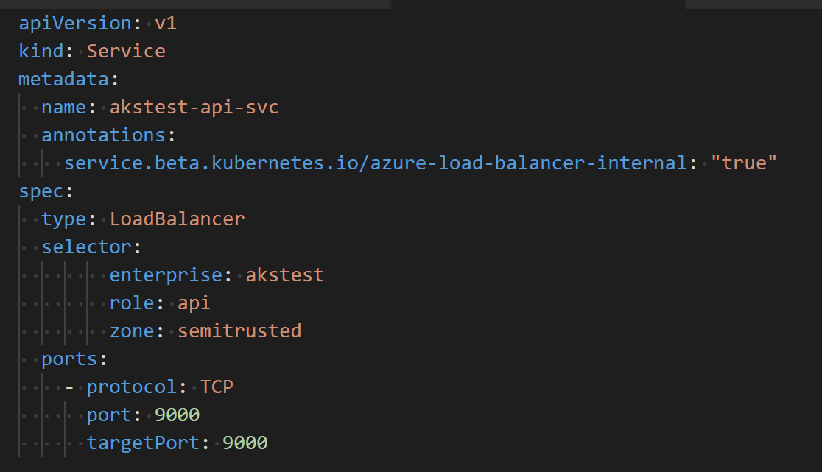
Internal Load Balancer

Slide 8
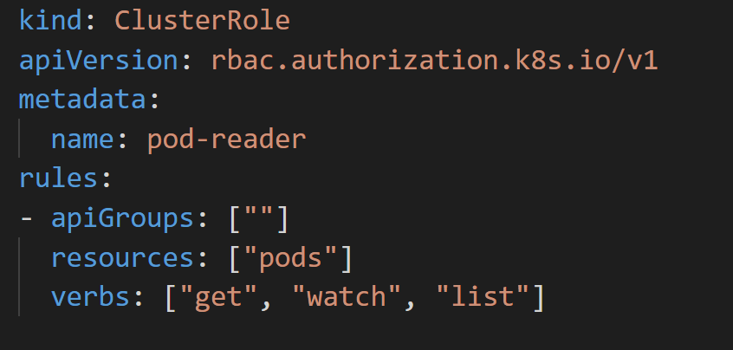
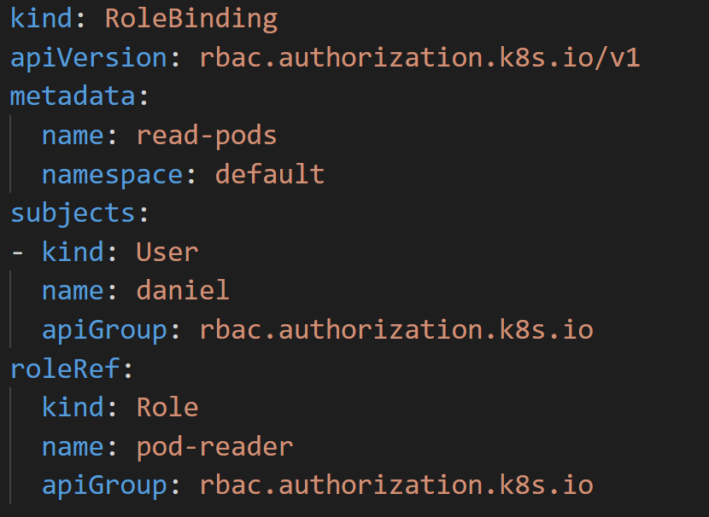
RBAC

Slide 9
Security
2. Configuring machines based on existing security requirements
Enterprises have hardening standards for Linux machines
Leverage k8s native methods to implement custom software on the nodes
Notes:
Daniel

Slide 10
Anti-Malware DaemonSet
Solution Design
DaemonSets create a pod on each worker node in the cluster
Pods can mount Volumes on the host using the “hostPath” parameter
The init.d directory in /etc/ on the node tells the node what programs need to be run
Implementation
Create a DaemonSet mounting the root directory on the node to copy the anti-malware program & modify init.d to install and run it
Useful for other utilities that aren't easily deployed using a container
Notes:
Daniel

Slide 11
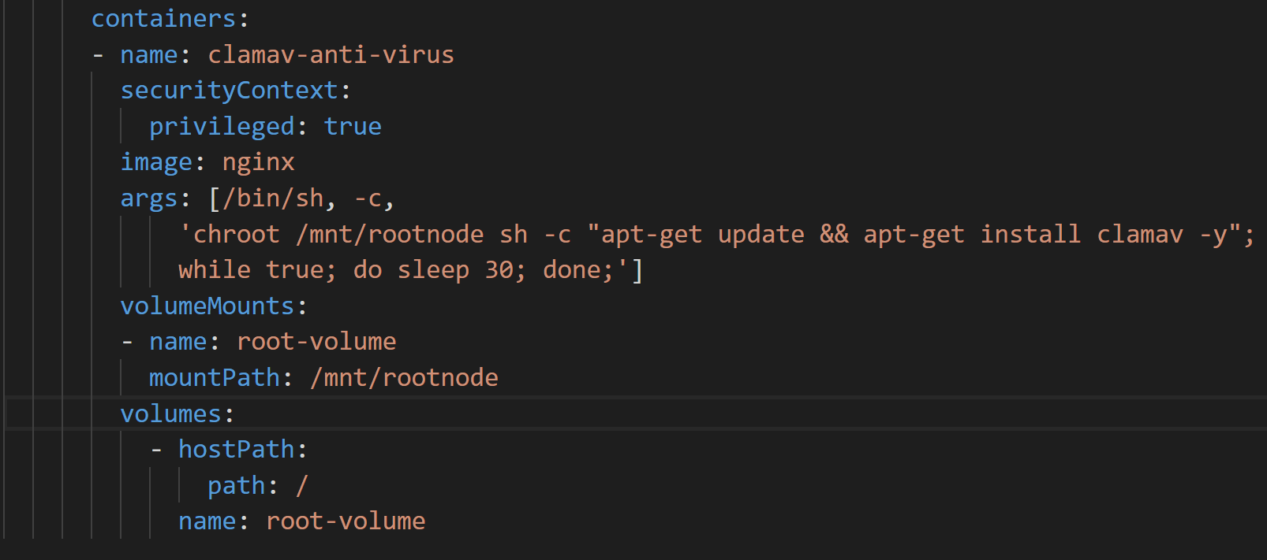
Anti-Malware DaemonSet
Notes:
Daniel

Slide 12
Security
3. Securing connection to on-prem resources
Configure the virtual network for hybrid connections
Notes:
Sujit

Slide 13
Hybrid Connections
Custom Virtual Network configuration when deploying the managed cluster.
The Virtual Network of the Cluster is configured to connect to the on-premise circuit.
Allows any Pod to access on-premises resources such as database servers, mainframes, SIEM systems etc.
Notes:
Sujit

Slide 14
Security
4. Ensuring all cluster egress follows regulatory and compliance requirements
Configure App Proxies for all application egress
Notes:
Sujit

Slide 15
App Proxies
All Internet traffic must be forced through a proxy server
Set HTTP_PROXY and HTTPS_PROXY environment variables
Automate through Startup Scripts
Notes:
Sujit

Slide 16
Security
5. Enforcing secure communications between all application components
Install custom certificates as part of app bootstrapping and enforce TLS via app config
Notes:
Daniel

Slide 17
Certificates
Problem – Installing Custom CA Certificates and SSL certificates
Most Enterprises use their own custom CA.
How do you get the CA certs onto the containers?
Using startup scripts
Download certificates from cloud storage
Install in correct location in container
Enforcement is framework specific
Notes:
Daniel, Sujit discusses app enforcement

Slide 18
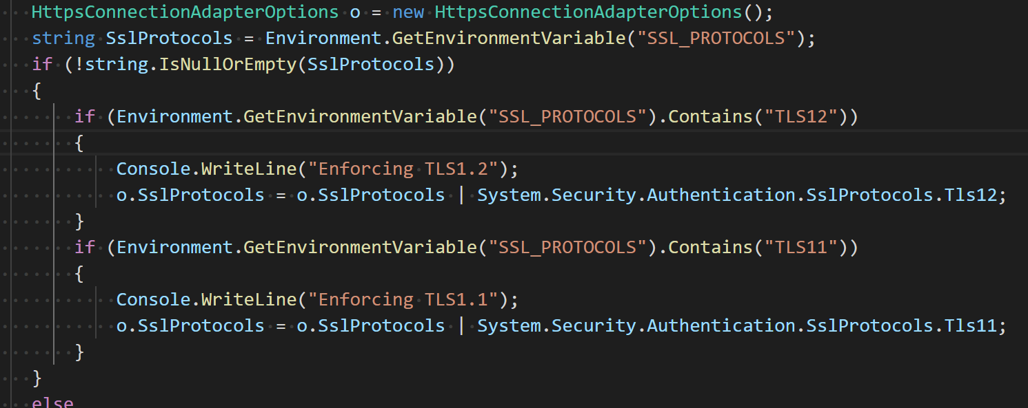
ASP.NET Core Example

Slide 19
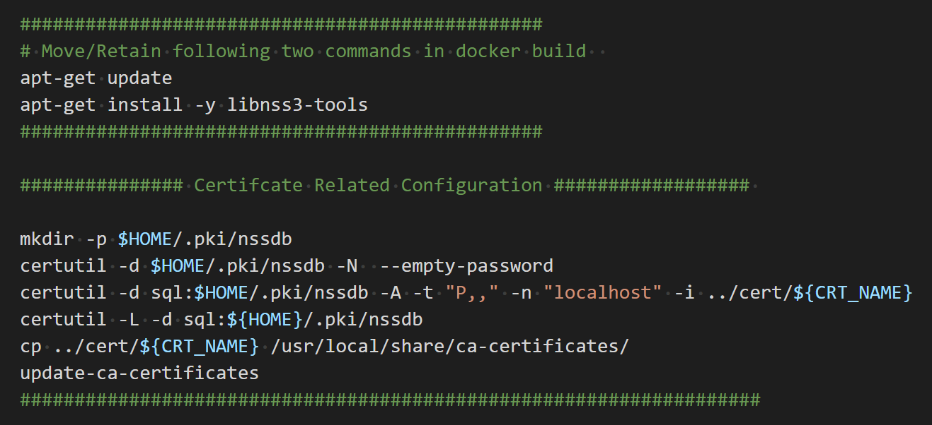
Certificates

Slide 20
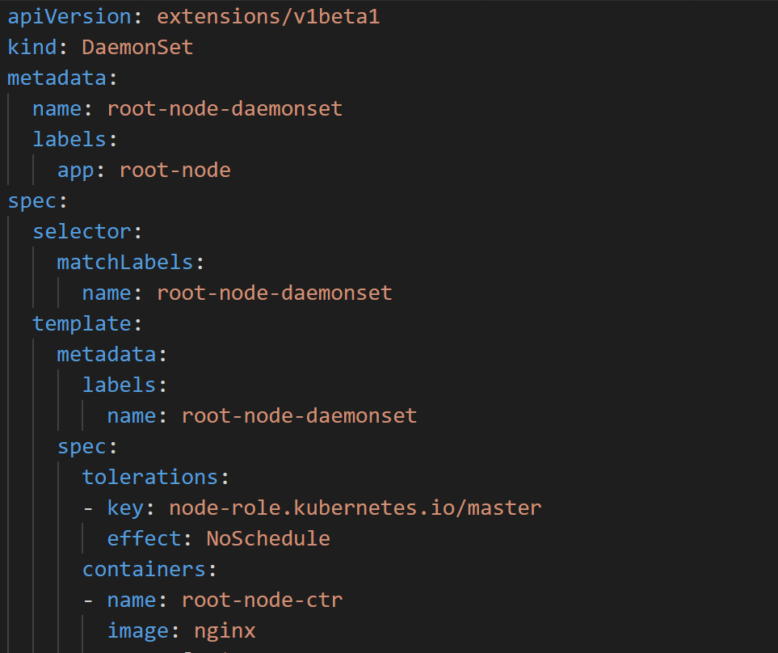
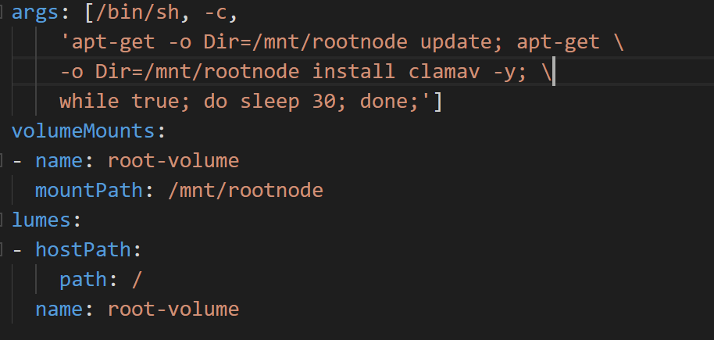
Demo: Anti-Malware

Slide 21
Monitoring
Logging
Configure verbose logging to stdout and stderr when developing your containerized applications
Splunk
DaemonSet that is built using the Splunk Universal Forwarder
Mounts the directory of container logs (stderr, stdout)
Forwards logs to Splunk Tenant.
Notes:
Sujit, Daniel for Logrotate

Slide 22
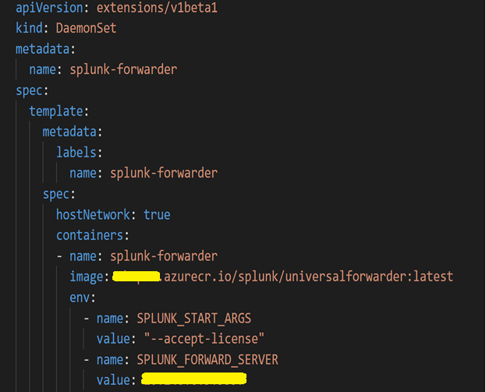
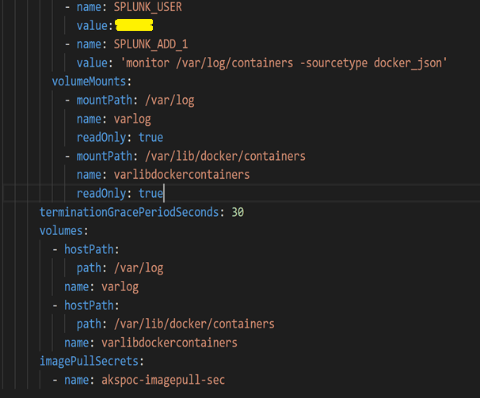
Splunk
Notes:
Sujit

Slide 23
Monitoring
Log Rotation
Managed Kubernetes Services typically have defaults for log rolling
Custom tools can be used to configure log rolling for your requirements
LogRotate DaemonSet for example
Notes:
Sujit, Daniel for Logrotate

Slide 24
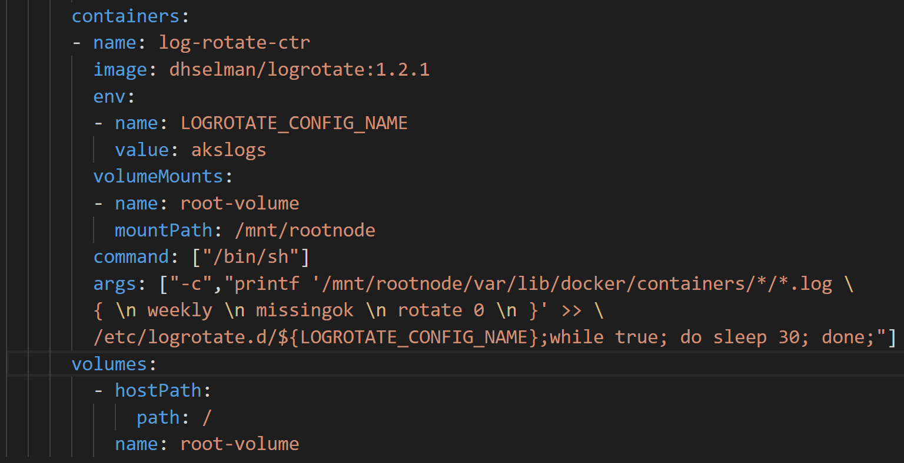
LogRotate DaemonSet

Slide 25
Applications
External configurations
Downloaded from Cloud Storage using startup scripts
Applied to the application configuration in the container
DevOps build processes
Automate build and container creation
Deployment to test cluster using Helm and Brigade
Common base images
All applications must use a set of pre-configured base images
These images are hardened with the latest updates and security settings.
Applications are overlayed on top of these base images.

Slide 26
Managed all the way
Container registry service
Databases (SQL or NoSQL)
Storage (file shares)
Notes:
Sujit

Slide 27
Startup Script Use Cases
External App Configuration
SSL enforcement for Cluster Traffic
Custom Host Files
CA Certificates
TLS certificates
Time Zone setting
Plugging into the application startup process

Slide 28
Startup Scripts
Implementation
Store startup script (.sh or .cmd) in cloud storage
All applications include a small script which loads and runs this startup script before handing off control to the application entry point
Use secrets to store the URLs to the startup script

Slide 29
Other Topics
Virtual Node (Serverless)
Azure Files + Backup
Stateful containers can mount an SMB share and persist information.

Slide 30
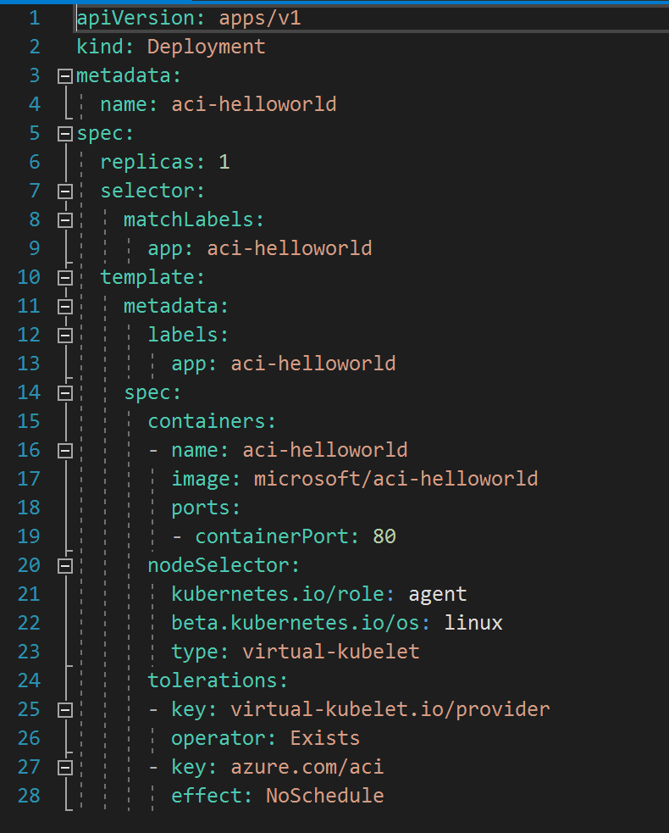
Virtual Node
Dynamically allocates resources using serverless resources.
Implemented with Azure Container Instances in Azure or Fargate in AWS etc.
Takes a few seconds to spin up Pods.
Good for burst traffic of short-running containers

Slide 31
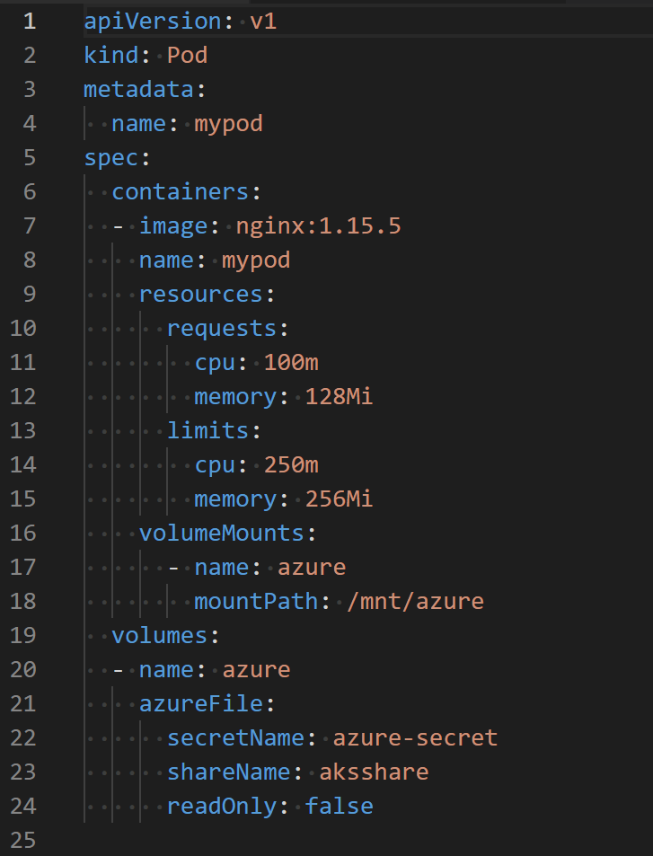
File Shares
Access existing SMB file shares form Pods
Use a Managed file service such as Azure Files
Great for sharing existing files from other internal applications
Files can be backed up

Slide 32
Demos
Anti-Malware
LogRotate
Splunk
Serverless
File Share

Slide 33
Managed K8s- Best Practices
Projects with heavy dependencies ought to be packaged and deployed using Helm
Leverage Pipeline variables to deploy YAML to different environments
Deploy and Administrate your clusters through the API (or kubectl) - no SSH!
Establish naming conventions for all artifacts
Image pulls should be from private, managed container registries
Use managed databases for any back-end services

Slide 34
Resources (Microsoft-centric)
Kubernetes concepts​ | New to Kubernetes and Azure Kubernetes Service (AKS)? Check out these docs to learn more about core Kubernetes concepts. ​ | https://docs.microsoft.com/en-us/azure/aks/concepts-clusters-workloads​
Kubernetes best practices​ | Interested in ensuring best results when you are using Kubernetes? Check out these best practices shared by AKS experts.​ | http://aka.ms/aks/bestpractices​
Microservices architecture reference​ | Learn how you can architect microservices with AKS​ | https://aka.ms/microservices-aks​
Phippy Goes To The Zoo​ – online download | Join Phippy on her new adventure as she takes her niece on an educational trip to the Kubernetes Zoo and learns about ingresses, CronJobs, CRDs, and more! Download now.​ | https://aka.ms/childrensguide2​
Brendan's Distributed Systems webinar​ | Join Brendan Burns, cofounder of Kubernetes, to learn how to use the concepts, patterns, and practices outlined in his e-book, Designing Distributed Systems.​ | https://info.microsoft.com/ww-ondemand-designing-distributed-systems.html​
Brendan's running Kubernetes in production webinar​ | Register for this webinar to help structure your projects for Kubernetes. Kubernetes co-founder Brendan Burns will walk you through a file system layout to prepare your application for Kubernetes and organize for a weekly or daily release. ​ | https://aka.ms/k8s/Brendan-production-video ​

Slide 35
